Slide 1

GOVERNMENT COLLEGE OF ENGINEERING , SALEM-11
(An Autonomous Institution Affiliated to Anna University , Chennai NAAC Accredited A++)
DEPARTMENT OF ELECTRONICS AND COMMUNICATION ENGINEERING
MINI PROJECT-22EC601
SMART LUGGAGE SAFETY SYSTEM WITH MULTI-LAYER THEFT DETECTION
PROJECT GUIDE:
Dr. G.Kavitha,
Assistant professor,
Department of ECE.
TEAM MEMBERS :
DEEPASRI P -2303617710622007
SANDHIYA S -2303617710622039
SRIPRIYA K -2303617710622047
ISHWARYA LAKSHMI A -2303617710622701

Slide 2
ABSTRACT
This project presents an IoT-based smart luggage security system using the ESP32 for real-time monitoring and theft prevention. By integrating a Reed switch, LDR, MPU6050, and GPS, the system detects zip tampering, light intrusion, and unauthorized motion. To ensure reliability, it features a dual-mode operation (Wearable and Rack mode) with a built-in delay mechanism to eliminate false motion alarms. The system provides immediate security through a buzzer alert and transmits live location updates via GPS, offering an effective and robust solution for travel safety.

Slide 3
INTRODUCTION
Nowadays, luggage theft and loss are very common in public places like railway stations, airports, and buses.
Existing solutions mainly focus on tracking after theft, not preventing it.
So, there is a need for a smart system that can detect suspicious activity instantly and alert the user in real time.
Our project provides a smart IoT-based luggage safety system using sensors, GPS, and cloud technology.

Slide 4
LITERATURE SURVEY
S.No | Title & Author | Key Technologies | Limitation
1 | IoT Based Smart Luggage Monitor Alarm System — Valluripally et al. (2019), Springer | Arduino, BLE, GSM, GPS; detects luggage separation and sends SMS alerts | Limited to Bluetooth range; no tamper or zip detection
2 | Intelligent Travel Companion: The IoT-Enabled Smart Bag — Basha Sk et al. (2024), IJMTST | ESP8266, GPS, RFID/NFC, biometric authentication | Focus on tracking and biometric security; complex and costly
3 | Smart Luggage Carrier System with Theft Prevention and Real-Time Tracking — Santhana Krishnan et al. (2020), IEEE ICSCAN | Arduino Nano, GPS, GSM, automated following system | Focus on movement; no intrusion or zip detection
4 | Smart Luggage Tracking using IoT and GPS Technology — IJARCCE (2023) | Arduino Uno, GPS, GSM, IoT platform | Only tracking; no detection of bag opening or tampering

Slide 5
PROBLEM STATEMENT
The increasing cases of luggage theft highlight the need for improved security systems.
Existing solutions are mostly reactive rather than proactive.
They lack features like:
Real-time monitoring
Immediate alert mechanisms
Reliable sensor-based detection
Current luggage security systems lack multi-sensor integration.
They fail to detect zip tampering and light exposure.
Motion detection systems often generate false alerts due to noise.
Therefore, a smart IoT-based solution is essential.

Slide 6
OBJECTIVE
To provide safety and security for travelers’ luggage
To alert users immediately during suspicious activities
To allow users to monitor luggage remotely
To prevent theft before it happens
To make the system easy to use and reliable

Slide 7
PROPOSED SOLUTION
Developed an IoT-based smart luggage security system using ESP32
Integrated multiple sensors for detection:
Reed switch for zip opening
LDR for light/intrusion detection
MPU6050 for motion detection (rack mode only)
Implemented dual mode operation:
Wearable mode (motion detection disabled)
Rack mode (all sensors active)
Applied 7-second delay logic to reduce false motion alerts
GPS is used for location tracking
Alerts are sent through Telegram and buzzer
Data is stored and monitored using Firebase

Slide 8
BLOCK DIAGRAM
REED SWITCH
ESP32 (MAIN CONTROLLER)
BUZZER(ALERT OUTPUT)
THE USER
LDR SENSOR
USER INTERFACE (WEB DASHBOARD/ TELEGRAM APP)
MPU6050
WiFi MODULE (ESP32 ONBOARD)
GPS MODULE

Slide 9
FLOW DIAGRAM
START
Initialize ESP32 / Sensors / Connect to WiFi
A
Is System ON?
NO
STOP MONITORING
YES
Wearable or Rack?
WEARABLE
RACK
Read Zip/Light
Read Zip/Light/Motion
logic)
To SLIDE 2 (B)
To SLIDE 2 (B)

Slide 10
From SLIDE 1 (B)
B
Any condition TRUE? (Zip Open? OR Light Detected? OR Verified Motion?)
YES
Trigger Alert (Buzzer, GPS)
NO
C
Send Data to Web App
To SLIDE 1 (A)

Slide 11
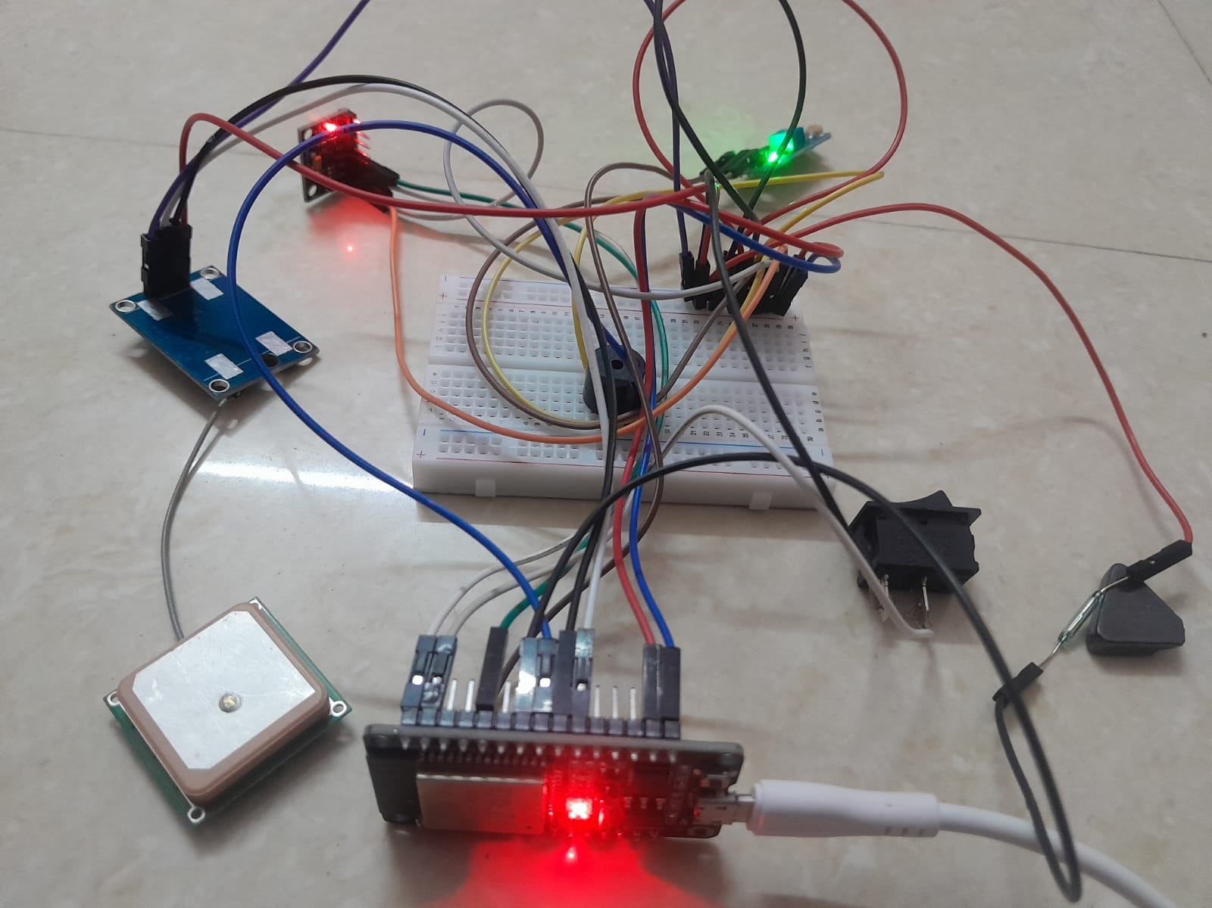
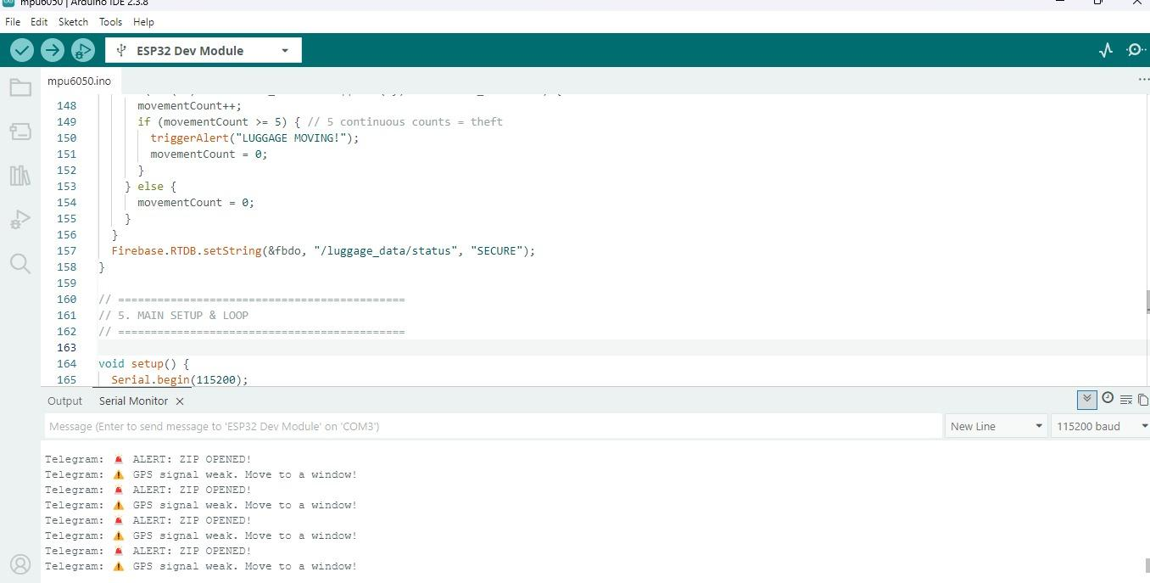
RESULTS
The Smart Luggage Safety System was successfully developed and tested. The system effectively detects theft attempts, monitors luggage status in real-time, and sends instant alerts to the user.
HARDWARE IMPLEMENTATION
ARDUINO CODE IMPLEMENTATION

Slide 12
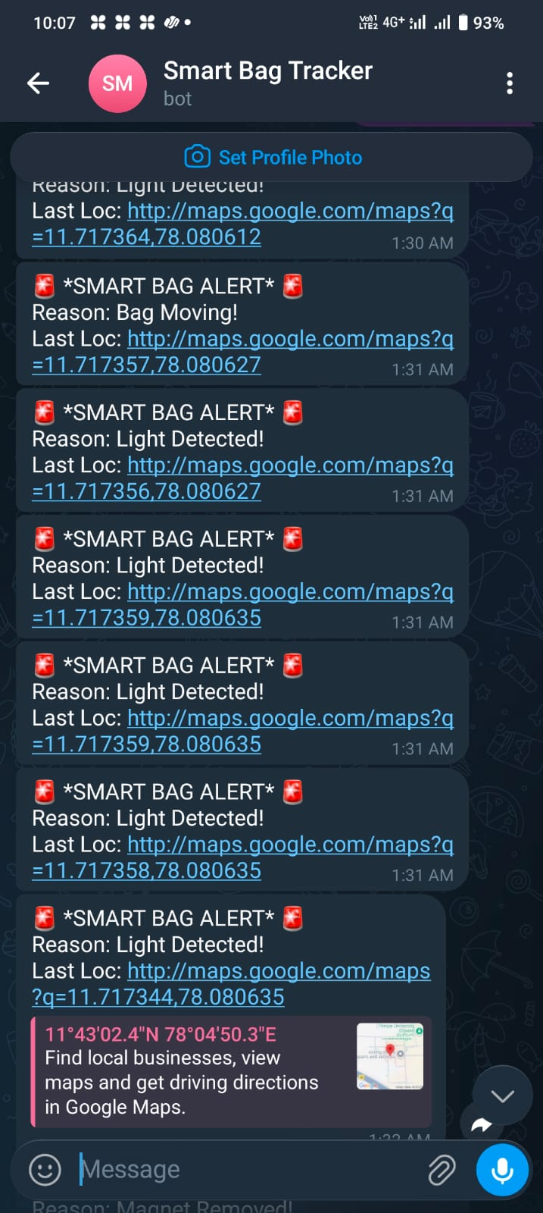
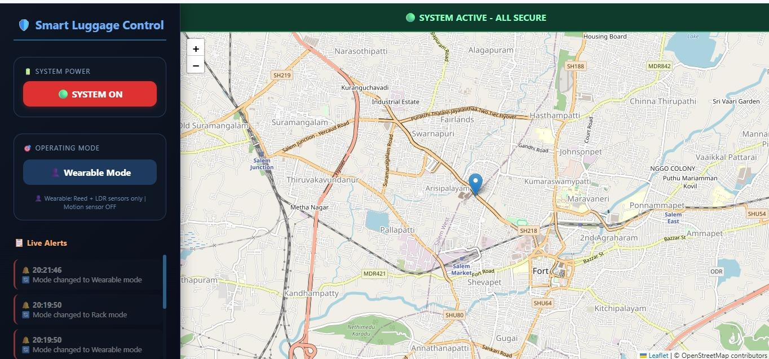
REAL TIME SYSTEM OUTPUT:
Web application displayed live alerts and system condition.
Location was displayed on the web dashboard using map interface.
Movement path of the luggage was tracked successfully.
Instant alerts were sent through Telegram with reason.
Alerts included real-time Google Maps location link.

Slide 13
FUTURE WORKS
Integrate a GSM module for offline SMS alerts without internet dependency
Make the system battery removal compatible for easy replacement, long-term use, and airport compliance
Implement indoor positioning using WiFi and BLE

Slide 14
CONCLUSION
A real-time IoT smart luggage security system has been developed, using Reed Switch, LDR, and MPU6050 sensors with Wearable/Rack modes and a 7-second verification logic to minimize false alerts. It delivers live notifications via web dashboard and Telegram, triggers a buzzer for instant warning, and integrates GPS for location tracking—providing a smart, reliable, and effective security solution for modern travelers.

Slide 15
REFERENCES
Valluripally S., Sukheja D., Ohri K., Singh S.K. (2019): "IoT Based Smart Luggage Monitor Alarm System," Springer ICIoTCT 2019.https://link.springer.com/chapter/10.1007/978-3-030-39875-0_31
Basha Sk K., Pravallika B., Swathi D., et al. (2024): "Intelligent Travel Companion: The IoT-Enabled Smart Bag," IJMTST, 10(02), 70-76. https://papers.ssrn.com/sol3/papers.cfm?abstract_id=4741661
Santhana Krishnan P.L., Valli R., Priya R., Pravinkumar V. (2020): "Smart Luggage Carrier System with Theft Prevention and Real-Time Tracking," IEEE ICSCAN. https://ieeexplore.ieee.org/document/9262445
IJARCCE (2023): "Smart Luggage Tracking using IoT and GPS Technology," Vol. 12, Issue 4. https://ijarcce.com/papers/smart-luggage-tracking-using-iot-and-gps-technology/

Slide 16
THANK YOU

